Slide 1
VPN Part 2
Matt Smith
IS: 8.6–8.9 / CIS: 22.6–22.9

Slide 2
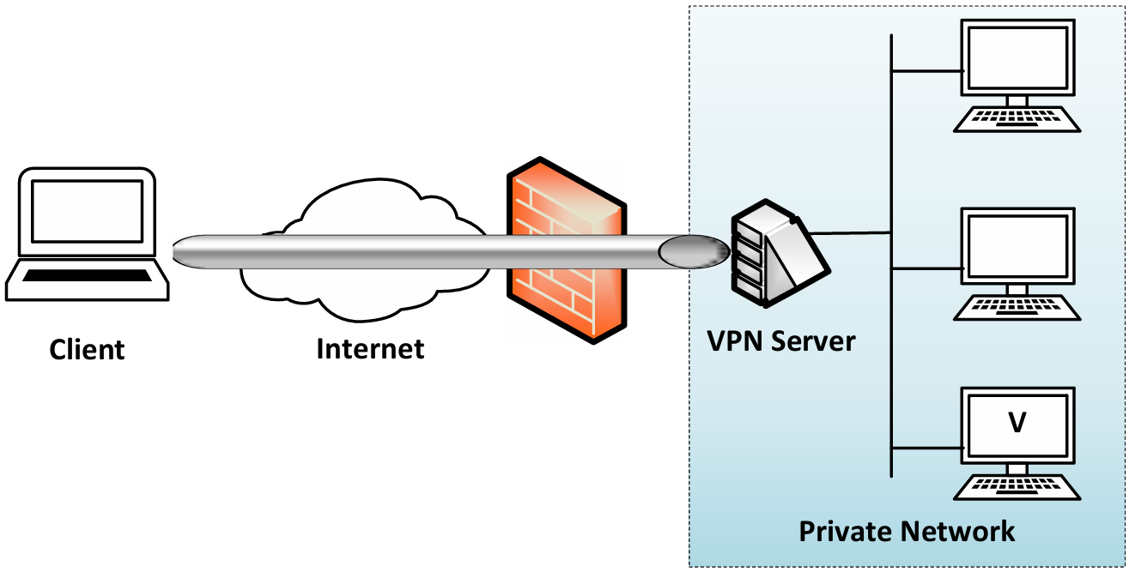
Recap: Building a VPN from Scratch
Why VPN? → Access private networks securely from outside
TLS/SSL Tunnel → wrap IP packets inside new packets
TUN Interface → virtual NIC that hands packets to our program
Routing → direct private-bound traffic into the tunnel
Two-way traffic → select() monitors both TUN and socket
Abbreviations
Virtual Private Network (VPN)
Transport Layer Security (TLS)
Secure Sockets Layer (SSL)
Internet Protocol (IP)
Network TUNnel (TUN)
Network Interface Card (NIC)
VPN Part 1 (Carlos)
IS: 8.1–8.5 / CIS: 22.1–22.5

Slide 3
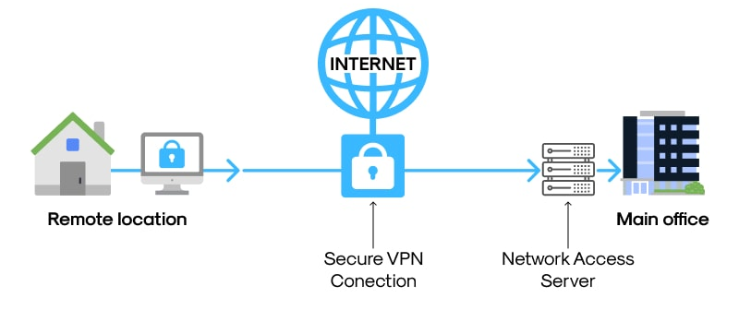
Why This Matters: VPNs in the Real World
Private networks exist everywhere: companies, hospitals, universities
Remote work & multi-site organizations demand secure access across the public Internet
Without VPN: traffic is exposed to capture, modification, and spoofing
With VPN: traffic travels through an encrypted tunnel: invisible to outsiders
Intro - Significance of the Topic

Slide 4

New Terms for Part 2
Abbreviations
Network Tap (TAP)
TAP Interface - Layer 2 counterpart to TUN; passes Ethernet frames
01
Bridging - connects two networks as one segment (vs. routing which keeps them separate)
02
Promiscuous Mode - lets a NIC capture all traffic, not just its own; required for bridging
03
ping / telnet - tools used to verify the tunnel works (§22.6)
IP Forwarding - allows the VPN client/server to act as a router between networks (§22.7)
04

Slide 5
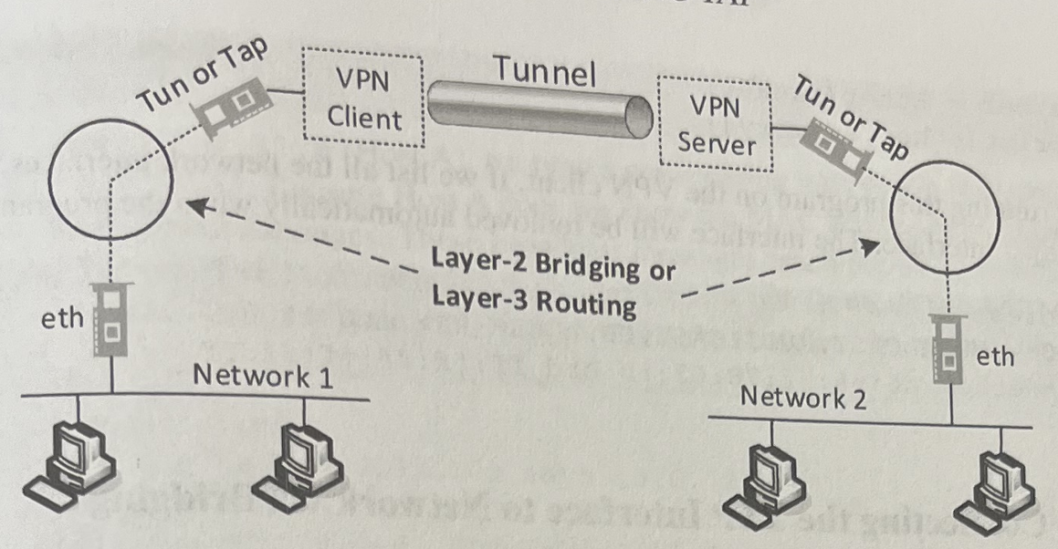
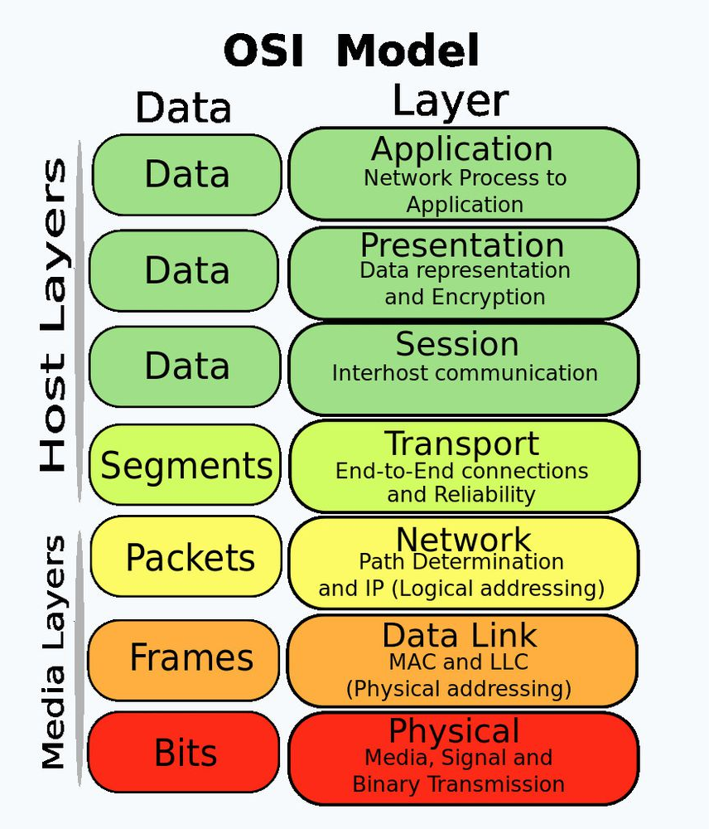
The OSI Problem VPNs Solve
Layer 3 VPN (TUN): uses routing to direct traffic into the tunnel
Layer 2 VPN (TAP): uses bridging so traffic appears on both networks as one
OSI Layer | Role | VPN Challenge | OSI Layer
Layer 3 (Network) | IP routing | Can't encrypt IP header as routers need it | Layer 3 (Network)
Layer 4 (Transport) | TCP/UDP | TLS/SSL tunneling operates here | Layer 4 (Transport)
Layer 2 (Data Link) | Ethernet frames | TAP interface bridges at this level | Layer 2 (Data Link)
7
6
5
4
3
2
1
Intro - The Specific Problem Within OSI Layers

Slide 6
What We're Covering Today
# | Section
1 | Recap: VPN Part 1 (CIS 22.1-22.5)
2 | Intro: Significance, OSI Context & Terminology
3 | Background: Topology, Implementation & Protocol
4 | Live Demos
5 | Conclusion: Summary, Solution & Future Research
6 | Popular VPNs
7 | Self-Reflection
8 | Connection to VPN Tunneling (IS: Ch. 9)
9 | Q&A
Intro - Presentation Outline

Slide 7
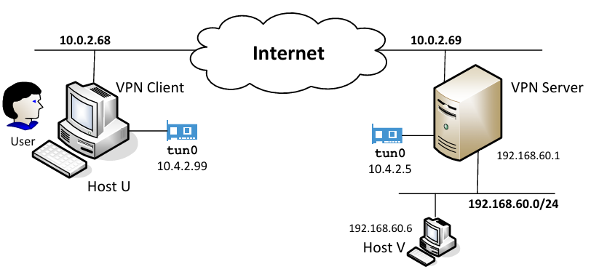
Network Configuration
Abbreviations
User Datagram Protocol (UDP)
Local Area Network (LAN)
Wide Area Network (WAN)
Ethernet interface (eth/en)
VPN Client - tun0: 10.4.2.99, eth: 10.0.2.68
VPN Server - tun0: 10.4.2.5, eth: 10.0.2.69, LAN: 192.168.60.1
Private Network behind server - 192.168.60.0/24
Host V - 192.168.60.6
Traffic from U → V travels over the Internet, encrypted inside a UDP tunnel
Return path: server decapsulates, releases packet onto the private network
eth
eth
Background - diagram of network topology

Slide 8
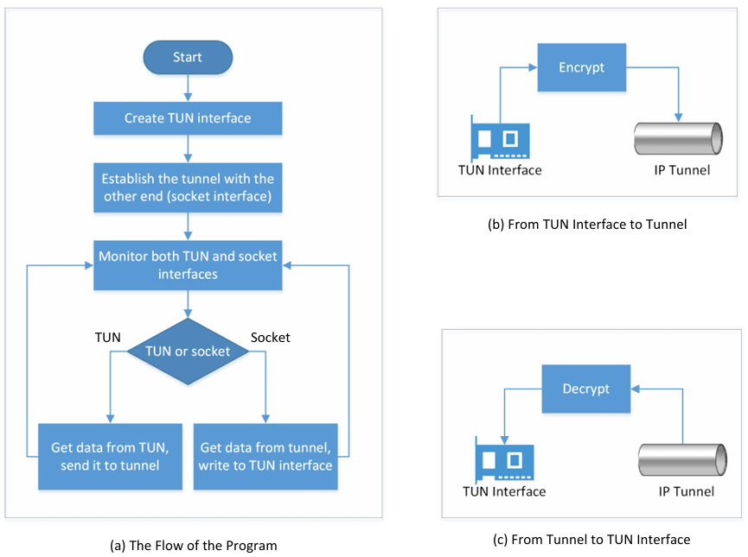
How the VPN Tunnel Is Implemented
Tunnel is built using UDP - the original IP packet becomes the UDP payload
No TLS/SSL encryption in this chapter - focus is on the tunneling mechanism, not encryption
Two programs working together: tun_client.py and tun_server.py
select() monitors both TUN and socket simultaneously - whichever has data gets processed first
Two directions:
Outbound: TUN receives packet → encrypt → send via socket into tunnel
Inbound: Socket receives packet → decrypt → write to TUN → kernel delivers it
Background - understanding of the implementation

Slide 9
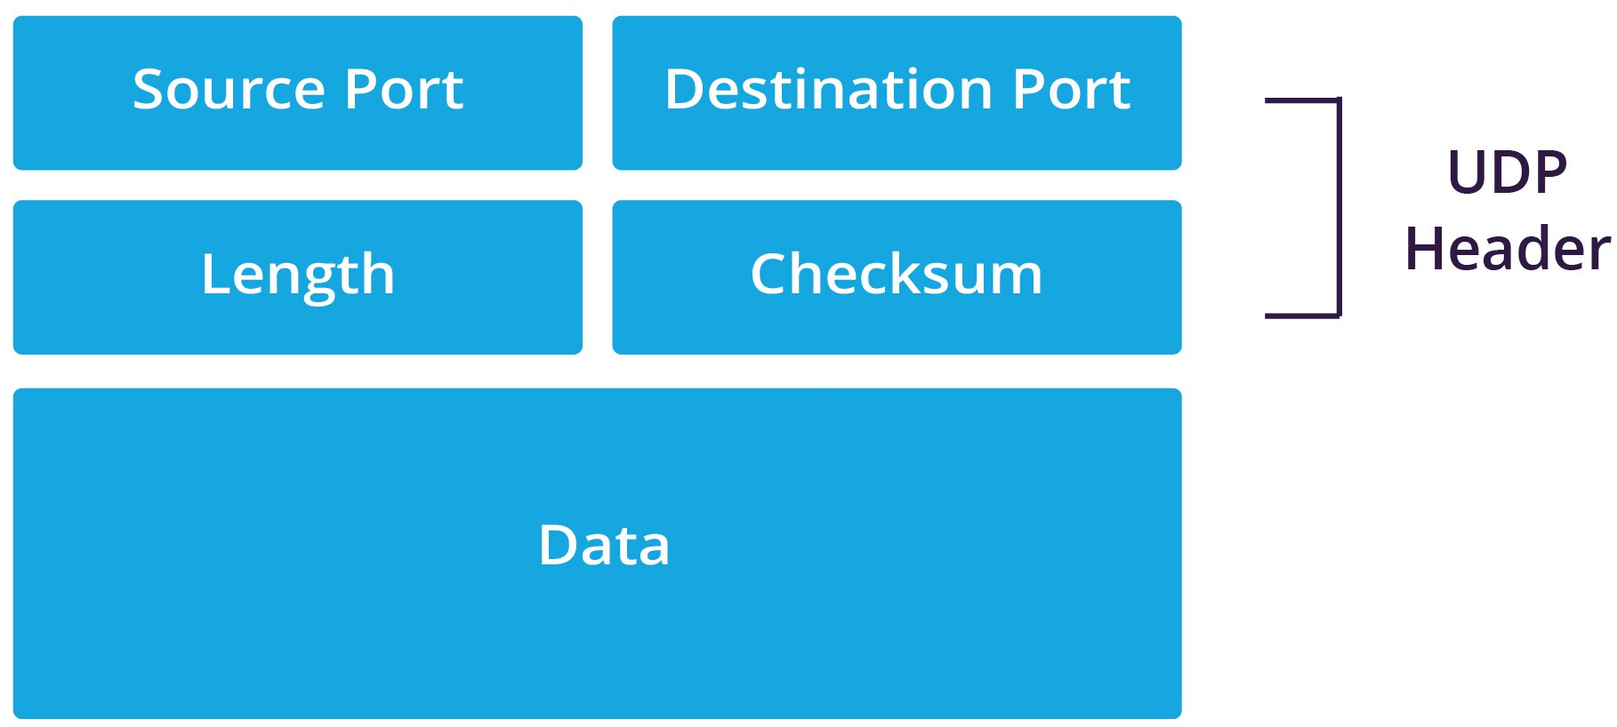
The Protocol: UDP Encapsulation
Outer packet (travels the Internet):
Field | Value
IP Header | Client → Server (10.0.2.68 → 10.0.2.69)
UDP Header | Source port → Dest port 9090
Payload | Original IP packet (encrypted in real VPN)
Inner packet (the original, released at the destination):
Field | Value
IP Header | Host U → Host V (10.4.2.99 → 192.168.60.6)
TCP/UDP + Data | The actual application data
Abbreviations
Transmission Control Protocol (TCP)
Background - understanding of the implementation

Slide 10
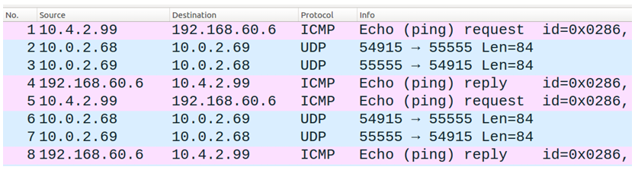
Demo 1: Does the Tunnel Work? (§22.6)
Abbreviations
Internet Control Message Protocol (ICMP)
What: Ping and telnet from Host U → Host V through the tunnel
Watch for: tcpdump on VPN client showing 8 packets (ICMP wrapped inside UDP)
Expected output:
Ping to Host V succeeds
Telnet: Connected to 192.168.60.6
Break tunnel → telnet freezes → reconnect → buffered chars appear

Slide 11
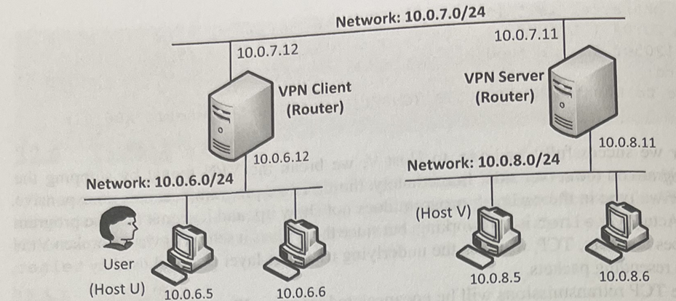
Demo 2: Connecting Two Networks via TUN (§22.7)
What: Full network-to-network VPN: 10.0.6.0/24 ↔ 10.0.8.0/24
Watch for: Routing table on client showing 10.0.8.0/24 dev tun0
Expected output:
Host U (10.0.6.5) pings Host V (10.0.8.5) successfully
tcpdump shows packets crossing the tunnel between subnets
Remove routing rule → ping fails immediately

Slide 12
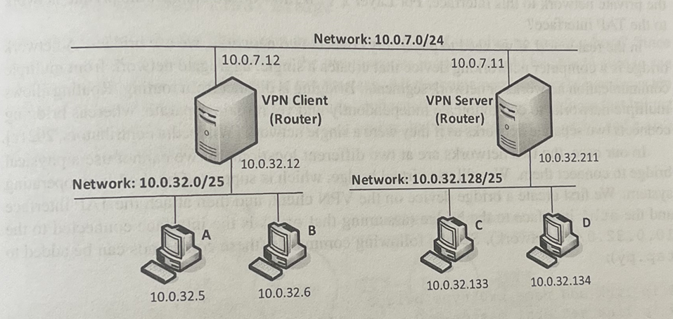
Demo 3: Bridging at Layer 2 with TAP (§22.8)
What: Layer 2 VPN, two subnets become one bridged segment via TAP
Watch for: ARP traffic crossing the tunnel (impossible with TUN)
Expected output:
arping from Host A → Host C succeeds across the tunnel
ping from Host A (10.0.32.5) → Host C (10.0.32.133) succeeds
Stop tap_client.py → all communication between A and C stops
Abbreviations
Address Resolution Protocol (ARP)

Slide 13
What We Built & What We Learned
Section | Key Takeaway
§22.6 Testing | A working VPN tunnel - ping and telnet confirmed end-to-end
§22.7 TUN | Extended to two full networks using routing + IP forwarding
§22.8 TAP | Bridged two networks at Layer 2 - ARP and all
§22.9 | TLS/SSL tunneling > IPSec: flexible, user-space, buildable from scratch
VPN = tunnel + encryption + authentication so this chapter proved the tunnel
The same TUN/TAP mechanism powers real-world VPNs (OpenVPN, WireGuard)
Abbreviations
Internet Protocol Security (IPSec)
Conclusion - provide a concise summary of the presentation

Slide 14
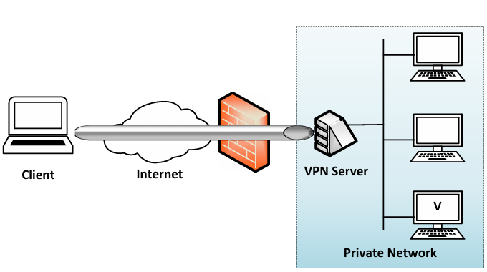
The Problem, Solved
Problem: How do you send IP packets securely across a public network without breaking routing?
Solution: IP Tunneling, wrap the protected packet inside a new unencrypted one
TUN/TAP lets a user-space program intercept and handle packets before they hit the wire
Result: remote hosts behave as if they are physically inside the private network
Conclusion - reiterate the solution to the main problem

Slide 15
Where This Goes Next
Add TLS/SSL encryption: the tunnel exists; securing the payload is the natural next step
Performance analysis: UDP tunneling overhead vs. raw throughput; TCP-over-UDP retransmission behavior
Split tunneling: route only some traffic through the VPN, not all
VPN detection & evasion: how firewalls fingerprint VPN traffic and how obfuscation counters it
WireGuard vs. OpenVPN vs. IPSec: compare real implementations against what was built here
Conclusion - discuss potential directions for future research

Slide 16
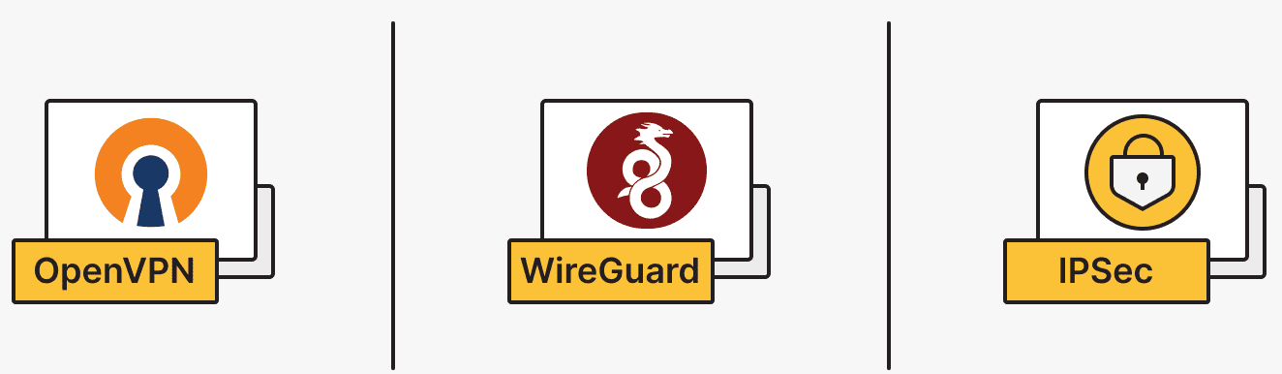
From Scratch to the Real World
Protocol | Layer | Tunneling | Built On
OpenVPN | 3 (TUN) or 2 (TAP) | TLS/SSL over UDP or TCP | Exactly what we built
WireGuard | 3 (TUN) | UDP + modern crypto | Same TUN interface, kernel-integrated
IPSec/IKEv2 | 3 | Kernel-level | Operates at IP layer, not user space
L2TP/IPSec | 2 | Ethernet over IPSec | Layer 2, similar concept to TAP
OpenVPN literally uses TUN/TAP, what you just saw is its foundation
WireGuard is ~4,000 lines of code Dloran1 vs OpenVPN's massive codebase, simplicity by design
WireGuard outperforms OpenVPN by ~57% in speed benchmark
Popular VPNs

Slide 17
How the Course Changed How I See VPNs
Before: VPNs were a black box, "it encrypts your traffic somehow“
After: understood every layer, TUN/TAP, routing tables, packet encapsulation, select()
Network security concepts (firewalls, IP spoofing, attack surface) became concrete not abstract
Building from scratch revealed what commercial tools like OpenVPN are actually doing under the hood
Self-Reflection — Course Material & Understanding

Slide 18
What I'm Walking Away With
Abstraction is powerful: TUN/TAP hides complexity as user-space programs can manipulate IP traffic without touching the kernel
Configuration > code: The VPN program barely changed between §22.5 and §22.7 as routing rules did all the work
Layer matters: TUN vs TAP isn't just terminology as it determines what traffic can cross the tunnel and how networks are connected
Security is additive: The tunnel is real without encryption, but it's only truly private once TLS is layered on top
Self-Reflection — Key Takeaways

Slide 19
Beyond VPNs: The Bigger Pattern
Tunneling generalizes to any scenario where you need to carry one protocol inside another: SSH port forwarding, Tor, DNS tunneling
TUN/TAP generalizes to any user-space network tool: packet analyzers, firewalls, network emulators
The attacker's lens: if a tunnel can bypass a firewall legitimately (§22.8 firewall bypass), it can also be abused as DNS tunneling and covert channels use the same idea
Countermeasure: deep packet inspection (DPI), VPN traffic fingerprinting, and anomaly detection exist precisely because tunnels can hide malicious traffic
Self-Reflection — Generalizing to Similar Scenarios

Slide 20
Handing Off to Parker
Today covered the mechanics: tunnel, routing, bridging, testing
Parker will connect these concepts to the broader VPN tunneling landscape (IS: Ch. 9)
Connection to VPN Tunneling (Parker)
IS: 9

Slide 21

Q&A

